Slide 1
Why PG?
Using resources that just work

Slide 2
Agenda
Who are PG Online?
What do they do?
Duplication of efforts
What is contained in their materials?
What is the impact on our teaching and learning?
Purchase options

Slide 3
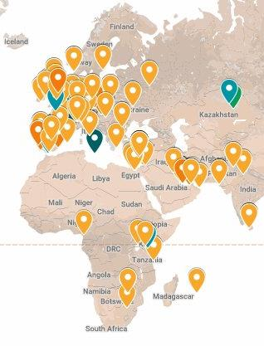
Who are PG Online?
Successful independent team of teachers creating editable teaching units and textbooks
Launched in 2013
Former teachers with a team of highly experienced educational authors
Based in our rural offices in Dorset
2,500 UK and worldwide school customers

Slide 4
What do PG Online do?
Creators of teaching resources and textbooks for KS3, GCSE, IGCSE, BTEC and A Level
Specialists in STEM subjects including Business, Chemistry, Design & Technology, Maths and Computer Science
All major examination boards covered, with materials that directly follow each specification
Complementary textbooks perfectly follow the digital teaching resources

Slide 5
Duplication of efforts
Even before a teacher begins their working day, they must create their own tools
PG Online asked, “Why?”
Why does every teacher create a separate resource on the same national specification points?
How could this time be better spent in schools?

Slide 6
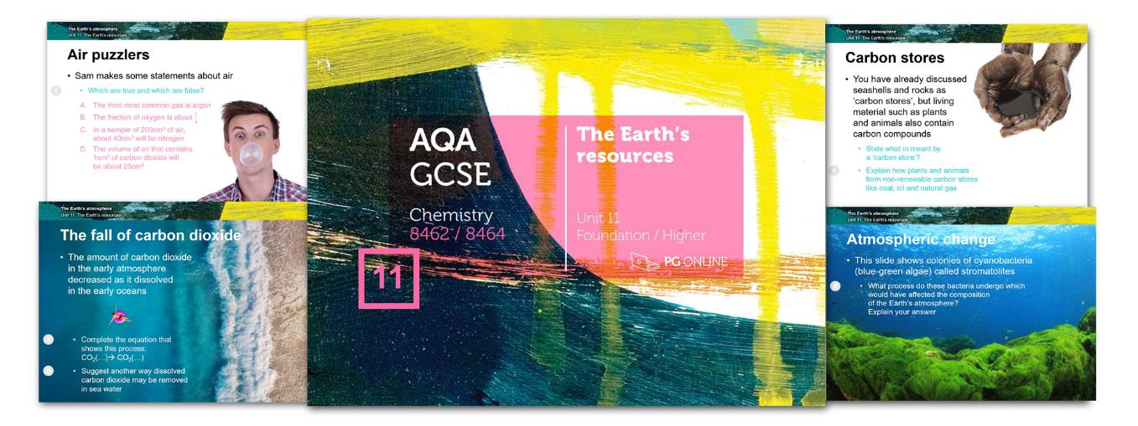
Engaging, rich resources
Highly absorbing content designed with differentiated questioning, problem solving skills and reasoning at the heart of everything

Slide 7
A complete curriculum
A specification is broken down into teaching units
Each unit contains:
A series of lessons with stimulating presentations covering each specification point
Worksheets and examination-style homework exercises targeting each learning objective, with answers
A complete examination-style assessment based on the specification, with mark scheme
A complete teacher’s guide containing lesson plans and supporting information

Slide 8
Computer Science Lessons

Slide 9
Maths lesson contents

Slide 10
Chemistry lesson contents

Slide 11
Business lesson contents

Slide 12
Design & Technology lessons

Slide 13
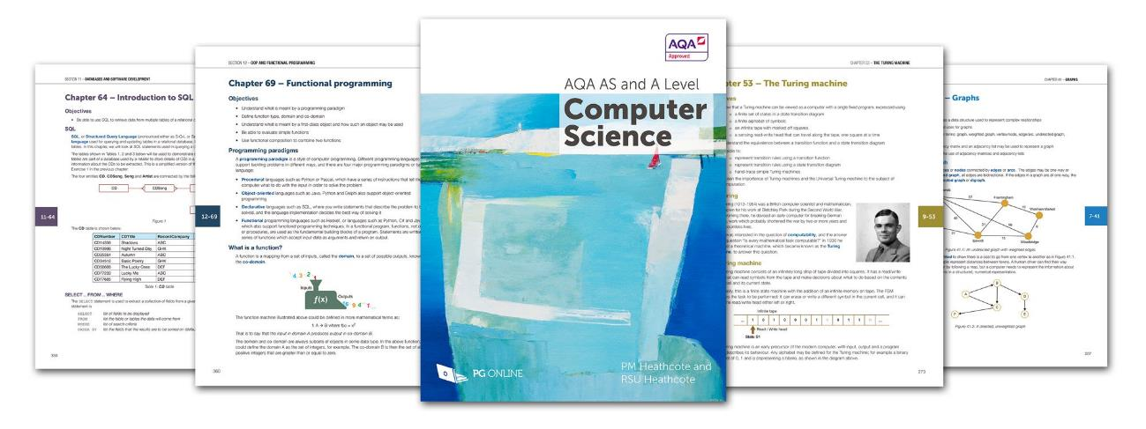
Clean, uncluttered textbooks
The linear approach to textbook design keeps the focus on the content and not on the features
Key questions on each spec point throughout every chapter

Slide 14
Consistency and training
Creates a consistent delivery across the whole teaching department
Provides resources for the whole department and students to use
Other schools find it more effective to learn from teaching resources over time than to pay for expensive day courses

Slide 15
Impact on T&L
Better results over a 3-year study of 60,000 students
Less planning provides more free time for student contact
Ideal support for new and non-specialists with cover solutions

Slide 16
Risk free
Free samples with all exam courses
100%, 100-day money back guarantee
Subject specialists available to answer queries
Materials work in conjunction with everything that already happens in a department
Need only fit in with current teaching where desired by each individual teacher
A library of outstanding resources to dip in and out of

Slide 17
Awards
PG Online have been recognised by every national and international education industry awards

Slide 18
Purchase options
Flexible purchase options:
Best value option has a one-off cost for lifetime ownership of as many or as few units as needed
Or:
Spread the cost of lifetime ownership over 2 or 3 years with the Budget Plan
Or:
Purchase a renewable, annual subscription for select series
Cumulative/volume discounts on multiple purchases

